Slide 1
Algorithms and Data Structures (CIS1002-N)
Week 5: Circular-Linked Lists
Module Leader: Dr Annalisa Occhipinti
Email: A.Occhipinti@tees.ac.uk

Slide 2
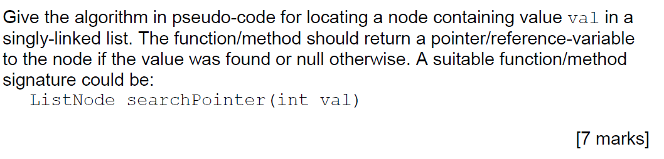
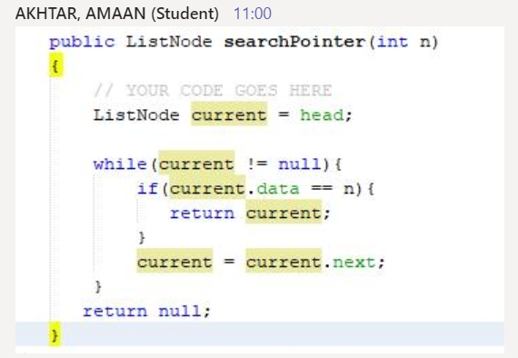
Homework: Exam Question. Search for a value
You should assume that the list is not ordered.

Slide 3
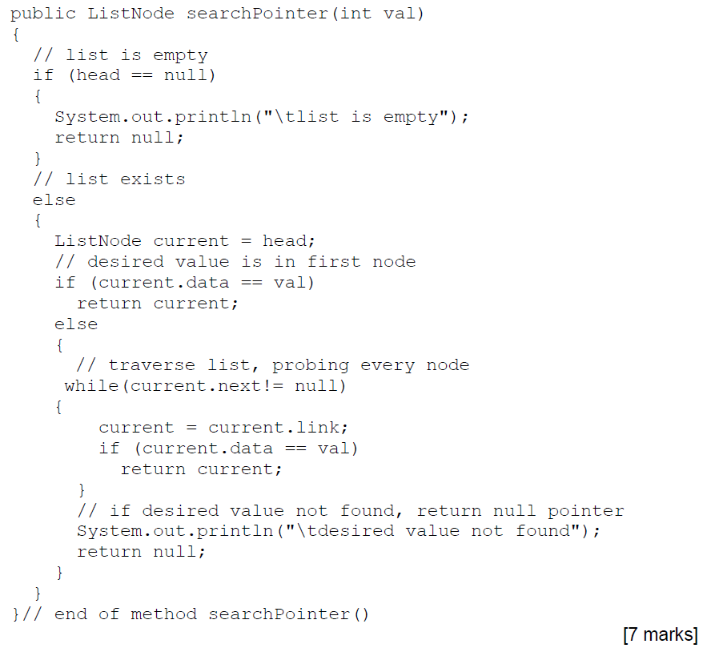
This is just one possible answer.
Make sure you add comments in your code.

Slide 4
Schedule
Week | Lecture (1hour) – Lab Session (2hours)
Week 1 | Introduction to Algorithms and related Data-Structures – Array ADT
Week 2 | Sorting : Bubble sort, Cocktail Shaker sort | ICA Briefing
Week 3 | Sorting : Selection sort and Insertion sort
Week 4 | Singular Linked-lists | ICA Briefing – Programming Tasks
Week 5 | Ordered Linked-Lists, Doubly Linked-lists
Week 6 | Circular Linked-lists
Week 7 | Stacks
Week 8 | Queues
Week 9 | Recursion
Week 10 | Recursion
Week 11 | Trees and balanced trees
 | Easter Break
Week 12 | Merge Sort and Quick Sort
Note: The schedule may be adjusted based on class progress.

Slide 5
A quick recap…
What’s the difference between the two while loops below?
ListNode current = head;
While(current!=null)
current = current.next;
ListNode current = head;
While(current.next!=null)
current = current.next;

Slide 6
Circular linked-lists
The last node points to the first node of the list
How do we know when we have finished traversing the list?
(Tip: check if the pointer of the current node is equal to the head.)
A
B
C
Head

Slide 7
Circular linked-list – 4 Quick Questions
How would you implement the following methods?
1) Determine whether the second element of the list is even or not. Boolean isSecondEven() | 2) Retrieve the first element of the list, return -1 if the list is empty.
3) Retrieve the last element of the list, return -1 if the list is empty. | 4) void addLast(int value) Add an element at the end of the list
Dummy-node
X
A
B
C
Head

Slide 8
Ordered Linked-Lists (either singly or circular)
Each node contains data which is “smaller” than or “equal” to the data contained in the next node.
Or … “greater” than or “equal” to
head
1500
1532
1564
1596
1628
1500
10
1532
12
1564
12
1596
32
1628
64
head
1500
1532
1564
1596
1628
1500
78
1532
65
1564
14
1596
11
1628
9

Slide 9
Searching an ordered list
Because “ordered/sorted”, the search process is improved:
Start search at first node,
Stop search as soon as we find a node with data greater than or equal to the searched item’s data,
Or we have searched the entire list.
Searching in an ordered linked-list or linked list. Which one would be faster?

Slide 10
Interview Question 1:
Inserting a node in an ordered circular linked list.
public void insert(int entry)
To insert an item:
Find the place where the new item is supposed to go,
Insert the item in the list.
2 Cases to consider:
Case 1: the list is initially empty.
Case 2: the new item is smaller than the smallest item in the list.

Slide 11
Ordered Circular Linked-lists
Operations:
Initialise the list
Determine whether the list is empty
Find the length of the list
Print the list
Make a copy of the list
Destroy the list
Search the list for a given item
Insert an item in the list
Delete an item from the list

Slide 12
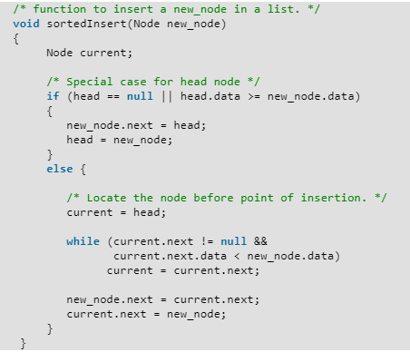
This solution is for singly linked list

Slide 13
Interview Q 2: Write the Java code for the method below Inserting a node after a node storing a given value
int insertAfterValue(int value, int searchvalue)
Specify searchValue after which new node with value is to be inserted.
int type, so return value will be position of new node in list.
Search for the first node containing searchvalue, keeping a count of its position in the list.
May reach end of list and not find searchvalue,then return sentinel value (-1).
Create new node.
Insert and return position in list.

Slide 14

And some more…
boolean addAfterPos(int obj, int index) – add a node after position index (in a 1-based index), if it exists. Return true is the new node has been added successfully. Return false if the node at position index does not exist.
ListNode searchPointer(int n) - return a pointer to node containing n, or null if not found.
int searchIndex(int n) - return a one-based index to node containing n, or
-1 if not found
What if the list is empty?

Slide 15
Week 5 - Test - Blackboard

Slide 16
Summary
Reviewed linked-lists.
Extended knowledge of linked-lists:
Ordered linked-lists
Circular lists
Next Week:
Doubly Linked Lists

Slide 17
Let’s have a look at the ICA….

Slide 18
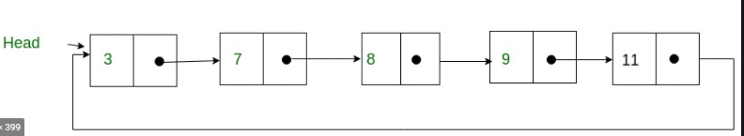
current
999

